Slide 1
NumPy
Library

Slide 2
NumPy
(Numerical Python)
Features and Advantages
Numerical Computation Package
Supports N-Dimensional array objects
Supports different data types
Faster Operation Speed
Used for performing mathematical functions pertaining to
Mathematical and logical operations
Fourier Transform
Linear Algebra
Random Number Generation
Vectorised Operation

Slide 3
Array Operations

Slide 4
Creating Arrays
Syntax:
import numpy
numpy.array(object)
Using Linespace
Syntax:
numpy.linspace(start, stop, num, dtype, retstep)
Where start, stop = range of array
num = no of samples inside the array
dtype = type of array
retstep = return sample size (if retstep=true)
Creating Arrays
Using arange()
Syntax:
numpy.arrange(start, stop, step)
Using ones() – Elements of Array is 1 always
Syntax:
numpy.ones(shape,dtype)
Using zeroes() – Elements of Array is 0 always
Syntax:
numpy,.zero(shape,dtype)
Using random.rand – Elements are always random no’s
Syntax:
numpy.random.rand(shape)

Slide 5
Other Operations
itemsize() – To get the size of array
Syntax:
numpy.nd array.itemsize
timeit() – To get time taken for performing the calculation
Syntax:
timeit np.sum(name)
shape(() – Returns an array size
Syntax:
array_name.shape
add() – To add two arrays elementwise
Syntax:
numpy.add(array 1, array2)
Other Operations
multiply() – To multiply elementwise
Syntax:
numpy.multiply(array_1,array_2)
transpose() – Changes the dimensions of the array
Syntax:
numpy.transpose(array)
append() – adds value at the end
Syntax:
numpy.append(array(axis))
insert() – adds value at given axis
Syntax:
numpy.insert(array, object, values, axis)

Slide 6
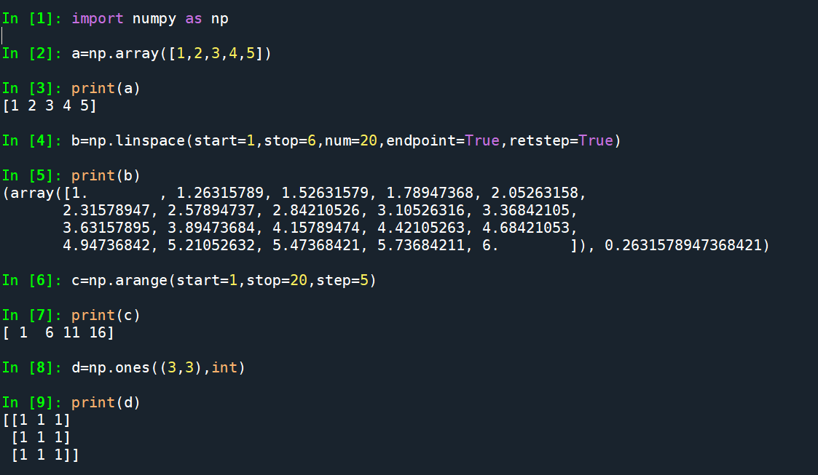

Slide 7
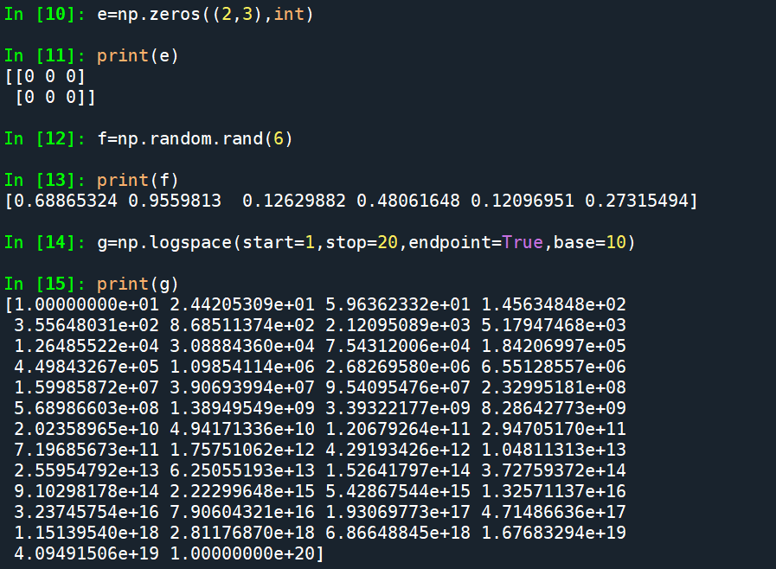

Slide 8
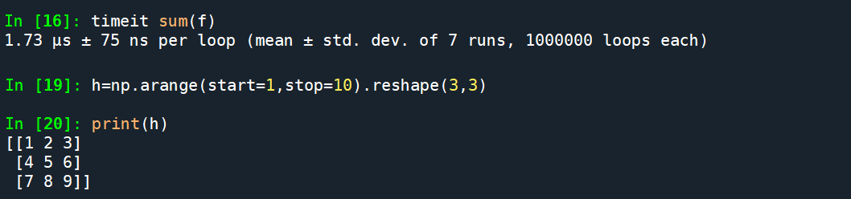
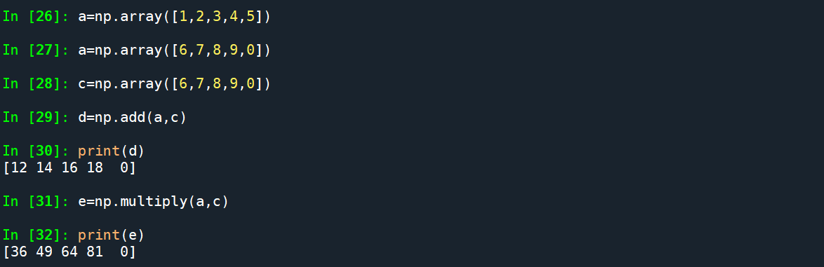

Slide 9
Matrix Operations (Linear Algebra)

Slide 10
Matrix Operations
Creating an matrix
Syntax: numpy.matrix(elements)
shape() – returns matrix from an array type object
Syntax: matrix_name.shape
shape[0]- returns no of rows
Shape[1]- returns no of columns
insert() – adds value at given part and axis
Syntax: numpy.insert(matrix, object, value, axis)
Determinant
Syntax: numpy.linalg.det()
Rank
Syntax: numpy.linalg.matrix_rank(matrix_name)
Inverse
Syntax: numpy.linalg.inv(matrix_name)
System of Linear Equations
Syntax: numpy.linalg.solve(matrix_a, matrix_b)

Slide 11
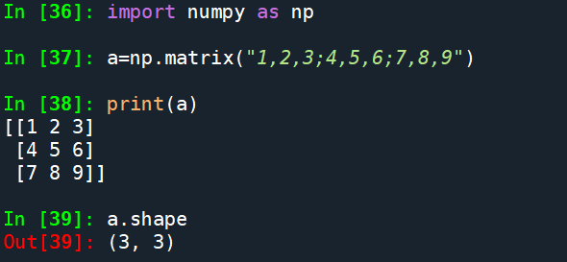
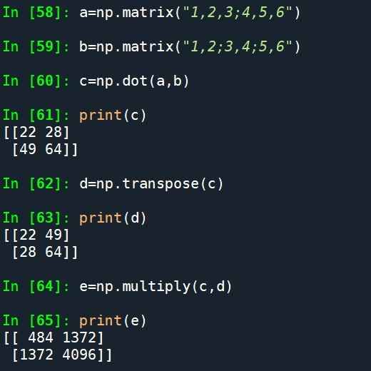
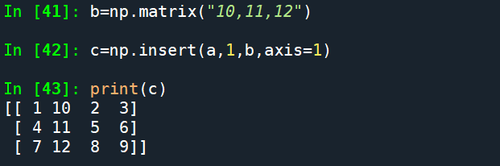
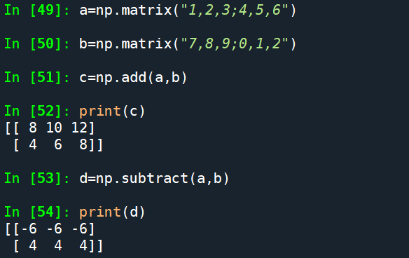
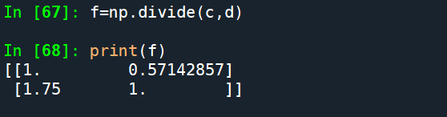

Slide 12
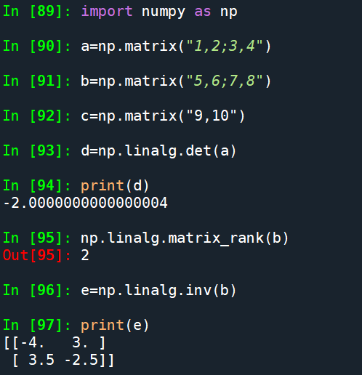
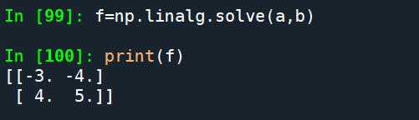

Slide 13
Thank You

